Slide 1
PACIO Project
Hl7 and the balloting process
7/6/2020

Slide 2
Objectives
About HL7
The balloting process
The balloting timeline
Where is PACIO Project in the balloting process?

Slide 3
HL7 Background
Founded in 1987, Health Level Seven International (HL7) is a not-for-profit, American National Standards Institute (ANSI)-accredited, standards developing organization.
HL7 provides a comprehensive framework and related standards for the exchange, integration, sharing, and retrieval of electronic health information that supports clinical practice and the management, delivery and evaluation of health services.
https://www.ansi.org/
https://www.hl7.org/about
https://www.bmc.com/blogs/osi-model-7-layers/

Slide 4
HL7 Standards and FHIR
HL7 standards define how information is packaged and communicated from one party to another, setting the language, structure and data types required for seamless integration between systems.
The Fast Healthcare Interoperability Resource (FHIR) specification is the latest standard to be created by HL7.
FHIR combines the best features of HL7’s v2, v3 and Clinical Document Architecture (CDA).
It leverages existing logical and theoretical models to provide a consistent, easy to implement, and rigorous mechanism for exchanging data between healthcare applications.
http://hl7.org/fhir/summary.html
https://www.hl7.org/fhir/overview.html

Slide 5
Balloting
Balloting is the formal process that HL7 uses to vet specifications prior to publication.
The objective of balloting is to actively seek feedback on a proposed standard and to ensure that the community that will be governed by that standard is in agreement with the expectations set by the standard.
Prior to balloting, IG developers must: (1) gain sponsorship from at least 1 out of the 37 HL7 work groups; (2) participate in at least 1 Connectathon; and (3) have at least 3 reference implementations.
What did PACIO Project submit for Ballot?
PACIO Project is working with the Community-Based Care and Privacy WG and Patient Care WG to submit the Functional Status and Cognitive Status Implementation Guides (IGs) for Ballot.
We want feedback on our proposed standard for exchanging Functional Status and Cognitive Status information between two healthcare settings.
https://confluence.hl7.org/display/HL7/HL7+Balloting

Slide 6

Ballot Levels
For Comment
Used early in the development cycle to solicit feedback from the community.
Intended to give guidance and direction to the Work Group developing the specification by soliciting review from the community.
Informative
Used to vet content that is not intended to be binding on implementers.
Often used for specifications that guide internal HL7 processes or that give non-binding recommendations/guidance to the implementer community.
Standard for Trial Use (STU)
Used to vet content that is eventually intended to be binding on implementers.
Used to vet content that is deemed "ready to implement" by the sponsoring work group, but where there has not yet been significant implementation experience.
Content development is sometimes done in iterations, especially if there are significant changes. Each iteration is labelled as STU1, STU2, STU3…
Normative
Used for final review of specifications that are intended to be binding on the implementer community and where there are strict rules around future changes to preserve a degree of forward and/or backward compatibility.
The specifications that result from this process are considered authoritative.

Slide 7
Additional Processes
Recirculation ballots
A special process invoked at the conclusion of some Normative ballots.
Limited to the pool of voters who submitted votes as part of the original Normative ballot process.
Highlight any issues where consensus could not be reached between the authoring Work Group(s) and some members of the ballot pool.
Peer Review
In some cases, when dealing with specifications that do not represent a standard or are early in the development lifecycle, HL7 may opt to forgo the balloting process and instead use a process of formal Peer Review.

Slide 8
Ballot Preparation
Submit the Project Scope Statement (PSS)
Complete three vendor implementations of the IG through participation in Connectathons
Submit the Notice of Intent to Ballot (NIB)
Complete the IG

Slide 9
Balloting Process
A “frozen” version of the specification is subjected to review during a scheduled time window.
Reviewers who have registered for the ballot can submit comments through JIRA about the specification that raise issues and propose changes.
Reviewers cast an overall vote indicating whether they believe the specification should be published in its current form.
The sponsoring Work Groups then review the comments provided and address them through a process called reconciliation.
Based on the responses from the Work Groups, the balloter may choose to adjust their vote by “withdrawing” negative votes.
The balance of affirmative votes received drives the final determination of whether the specification can proceed to publication as a “standard” (Although, the balance varies depending on the type of ballot, the threshold is generally 60% of affirmative votes).
https://confluence.hl7.org/display/HL7/HL7+Balloting

Slide 10
Ballot Tooling
Balloting in HL7 is managed through the use of two tools:
The HL7 Ballot Desktop manages ballot announcement and registration process and captures the formal record of ballot submissions and reconciliation for ANSI audit purposes. It also manages any recirculation ballots.
The Jira Ballot Process manages the submission of comments, the assignment of ballot weights to comments and the management of the overall vote of each registered balloter.

Slide 11
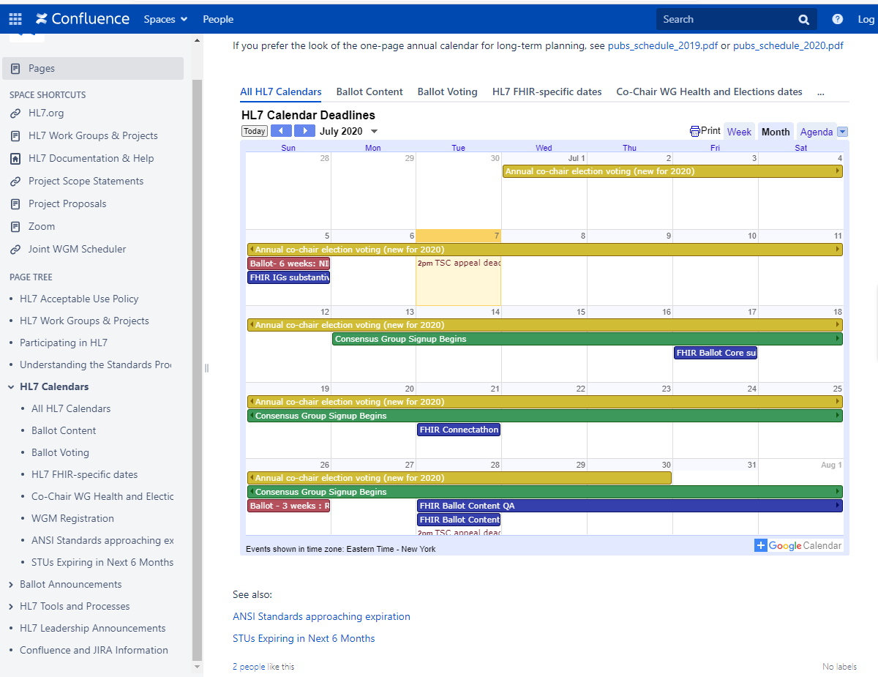
HL7 Calendar
https://confluence.hl7.org/display/HL7/HL7+Calendars#a024f57c-d5fc-4f39-8b26-bf9f1e280100-35717169

Slide 12

Balloting Timeline
21 Jun. 2020
FHIR IG Proposals due
5 Jul. 2020
Notice of Intent to Ballot/FHIR IG’s must be substantively complete
16 Aug. – 14 Sept. 2020
Ballot Open for Voting
19 Apr. 2020
Project Scope Statement Due

Slide 13
Who can vote?
HL7 Members
Non HL7 members with an administrative fee and strict instructions
Comments from non-members can still be submitted through JIRA, though they do not count towards ballot totals

Slide 14
Achieving Success
PACIO Meetings
Platform for members to provide input into the use cases, data models and development of the FHIR framework
Connectathons
Opportunity for vendors to test the client and/or server and provide feedback
Balloting
Proposing a standard that is validated and accepted by HL7 community
Adoption
EHR Vendors adopt the IG
___________________________
Participants take the role of server or client depending on the organization they represent
___________________________
Connectathon is like a “test kitchen” where the Implementation Guide is a “recipe” that can be tested and refined by participants
___________________________
To participate in a ballot, the group must strengthen their case by participating in Connectathons
____________________________
Adoption of the framework across the healthcare spectrum
Develop a FHIR Implementation Guide and Reference Implementation validated by the HL7 Community that EHR vendors will build into their system
Provide a standardized method of exchanging health information across healthcare settings

Slide 15
Participation In HL7
If you would like to know more about HL7 and participating in the HL7 standards process go to:
https://confluence.hl7.org/display/HL7/Participating+in+HL7

